Slide 1


SATYA JEET
6TH AUGUST 2022

Slide 2

Outline
Executive Summary
Introduction
Methodology
Results
Conclusion
Appendix

Slide 3
Executive Summary
Summary of methodologies
Data Collection through API
Data Collection with Web Scraping
Data Wrangling
Exploratory Data Analysis with SQL
Exploratory Data Analysis with Data Visualization
Interactive Visual Analytics with Folium
Machine Learning Prediction
Summary of all results
Exploratory Data Analysis result
Interactive analytics in screenshots
Predictive Analytics result

Slide 4
Introduction
Project background and context
we will predict if the Falcon 9 first stage will land successfully. SpaceX advertises Falcon 9 rocket launches on its website, with a cost of 62 million dollars; other providers cost upward of 165 million dollars each, much of the savings is because SpaceX can reuse the first stage. Therefore if we can determine if the first stage will land, we can determine the cost of a launch. This information can be used if an alternate company wants to bid against SpaceX for a rocket launch
Problems you want to find answers
What factors determine if the rocket will land successfully?
The interaction amongst various features that determine the success rate of a successful landing.
What operating conditions needs to be in place to ensure a successful landing program.

Slide 5

Section 1

Slide 6
Methodology
Executive Summary
Data collection methodology:
Data was collected using SpaceX API.
Perform data wrangling
Describe how data was processed
Perform exploratory data analysis (EDA) using visualization and SQL
Perform interactive visual analytics using Folium and Plotly Dash
Perform predictive analysis using classification models
How to build, tune, evaluate classification models

Slide 7
Data Collection
Describe how data sets were collected.
Data collection was done using get request to the SpaceX API.
Next, we decoded the response content as a Json using .json() function call and turn it into a pandas dataframe using json_normalize().
We then cleaned the data, checked for missing values and fill in missing values where necessary.
In addition, we performed web scraping from Wikipedia for Falcon 9 launch records with BeautifulSoup.
The objective was to extract the launch records as HTML table, parse the table and convert it to a pandas dataframe for future analysis.

Slide 8
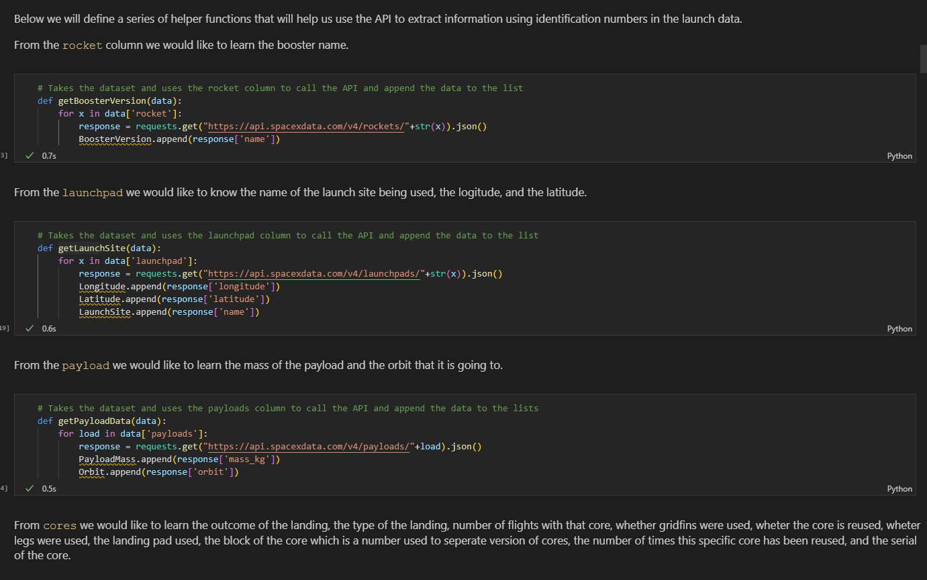
Data Collection – SpaceX API
We used the get request to the SpaceX API to collect data, clean the requested data and did some basic data wrangling and formatting.
Github url: LINK
https://github.com/sjeetgr8/THE-FINAL/blob/main/Applied%20Data%20Science%20Capstone%20IBM%20Skills%20Network/jupyter-labs-spacex-data-collection-api.ipynb
Place your flowchart of SpaceX API calls here

Slide 9
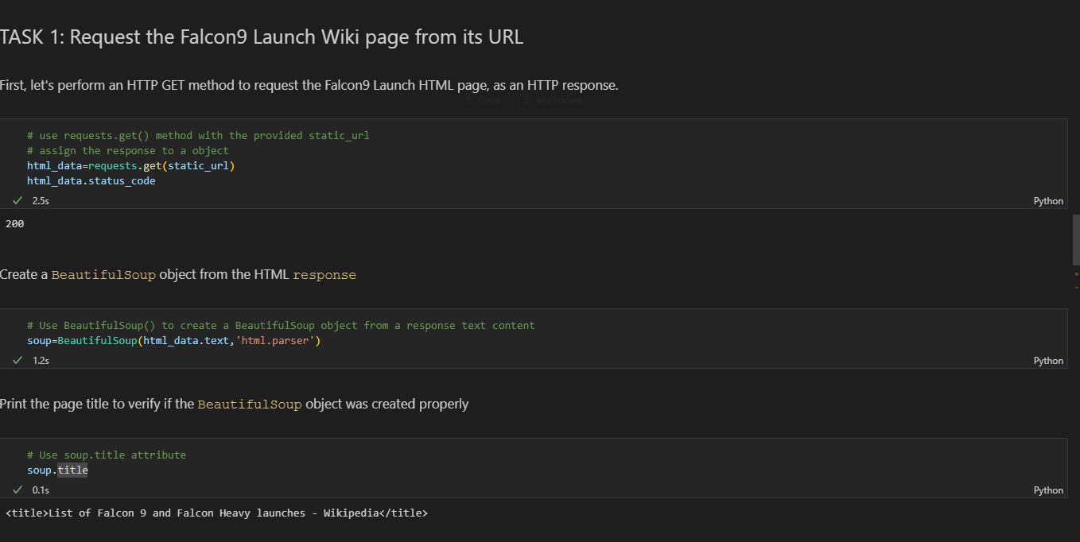
Data Collection - Scraping
We applied web scrapping to webscrap Falcon 9 launch records with BeautifulSoup
We parsed the table and converted it into a pandas dataframe.
https://github.com/sjeetgr8/THE-FINAL/blob/main/Applied%20Data%20Science%20Capstone%20IBM%20Skills%20Network/jupyter-labs-webscraping.ipynb
Place your flowchart of web scraping here

Slide 10
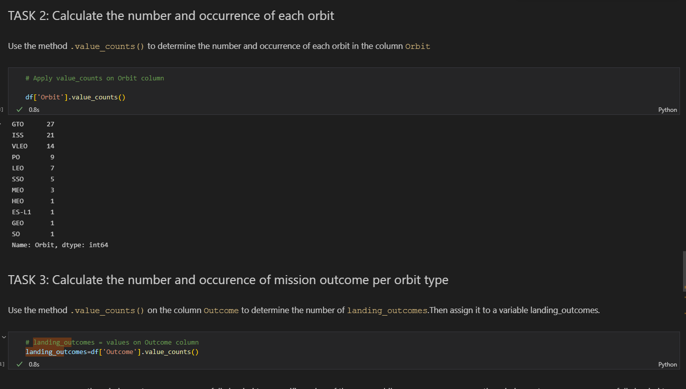
Data Wrangling
We performed exploratory data analysis and determined the training labels.
We created landing outcome label from outcome column and exported the results to csv.
https://github.com/sjeetgr8/THE-FINAL/blob/main/Applied%20Data%20Science%20Capstone%20IBM%20Skills%20Network/labs-jupyter-spacex-Data%20wrangling.ipynb

Slide 11
EDA with Data Visualization
We explored the data by visualizing the relationship between flight number and launch Site, payload and launch site, success rate of each orbit type, flight number and orbit type, the launch success yearly trend.
https://github.com/sjeetgr8/THE-FINAL/blob/main/Applied%20Data%20Science%20Capstone%20IBM%20Skills%20Network/jupyter-labs-eda-dataviz.ipynb

Slide 12
EDA with SQL
GROUP BY
ORDER BY
SELECT LIKE%
https://github.com/sjeetgr8/THE-FINAL/blob/main/Applied%20Data%20Science%20Capstone%20IBM%20Skills%20Network/EDA_SQL.ipynb

Slide 13
Build an Interactive Map with Folium
We marked all launch sites, and added map objects such as markers, circles, lines to mark the success or failure of launches for each site on the folium map.
We assigned the feature launch outcomes (failure or success) to class 0 and 1.i.e., 0 for failure, and 1 for success.
Using the color-labeled marker clusters, we identified which launch sites have relatively high success rate.
Github URL: https://github.com/sjeetgr8/THE-FINAL/blob/main/Applied%20Data%20Science%20Capstone%20IBM%20Skills%20Network/Folium.ipynb

Slide 14
Build a Dashboard with Plotly Dash
We built an interactive dashboard with Plotly dash
We plotted pie charts showing the total launches by a certain sites
We plotted scatter graph showing the relationship with Outcome and Payload Mass (Kg) for the different booster version
Github URL:

Slide 15
Predictive Analysis (Classification)
We loaded the data using numpy and pandas, transformed the data, split our data into training and testing.
We built different machine learning models and tune different hyperparameters using GridSearchCV.
We used accuracy as the metric for our model, improved the model using feature engineering and algorithm tuning.
We found the best performing classification model.
Github url: https://github.com/sjeetgr8/THE-FINAL/blob/main/Applied%20Data%20Science%20Capstone%20IBM%20Skills%20Network/ML.ipynb

Slide 16
Results
Exploratory data analysis results
Interactive analytics demo in screenshots
Predictive analysis results

Slide 17

Section 2

Slide 18
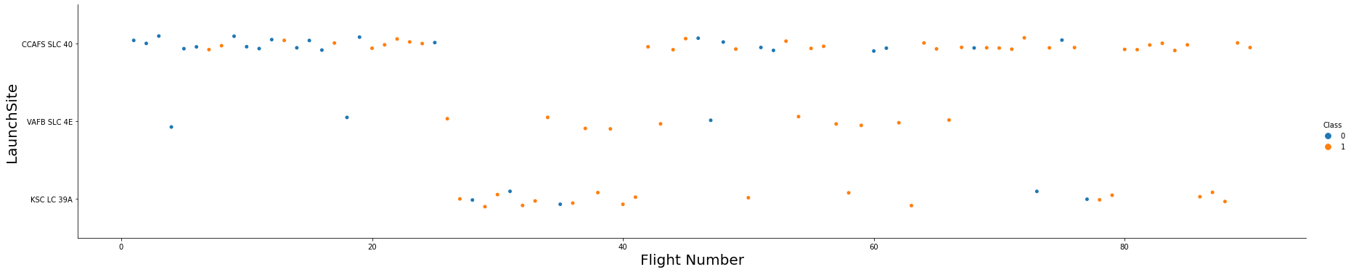
Flight Number vs. Launch Site
larger the flight amount at a launch site, the greater the success rate at a launch site.

Slide 19
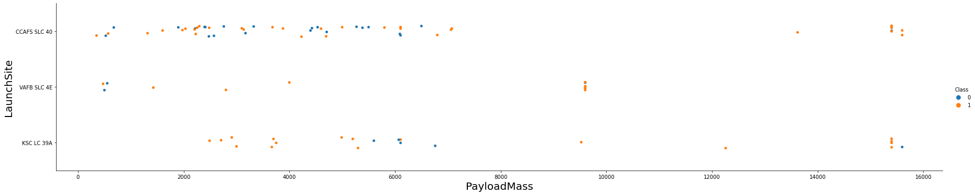
Payload vs. Launch Site
GREATER THE PAYLOAD MASS GREATR THE SUCCESS RATE

Slide 20
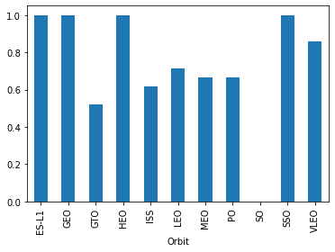
Success Rate vs. Orbit Type
ES-L1, SSO GEO and HEO has higher success rates.

Slide 21
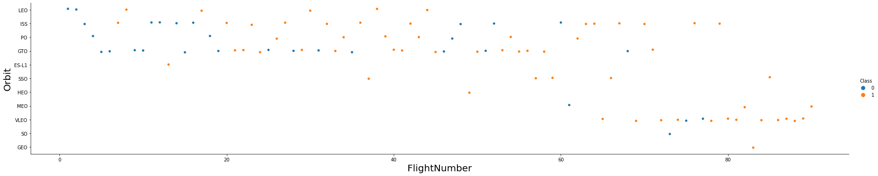
Flight Number vs. Orbit Type
There is no relationship between the flight number and orbit

Slide 22
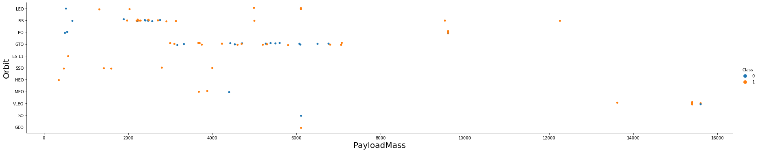
Payload vs. Orbit Type
with heavy payloads, the successful landing are more for PO, LEO and ISS orbits.

Slide 23
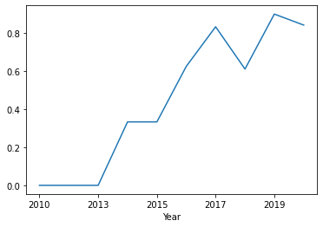
Launch Success Yearly Trend
Success is increasing linearly.

Slide 24
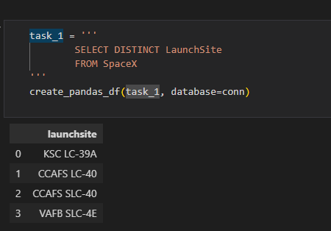
All Launch Site Names

Slide 25
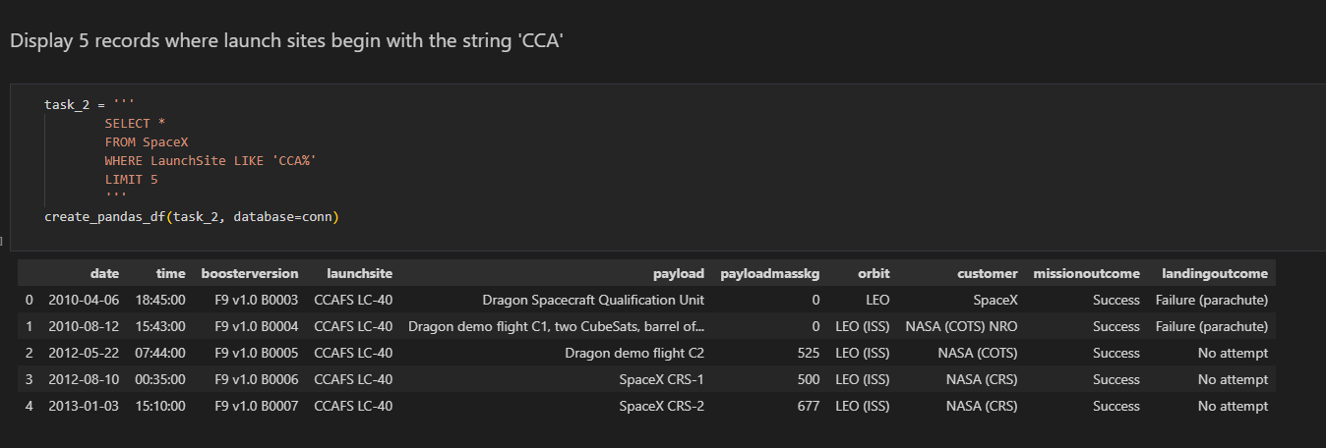
Launch Site Names Begin with 'CCA'
Find 5 records where launch sites begin with `CCA`

Slide 26
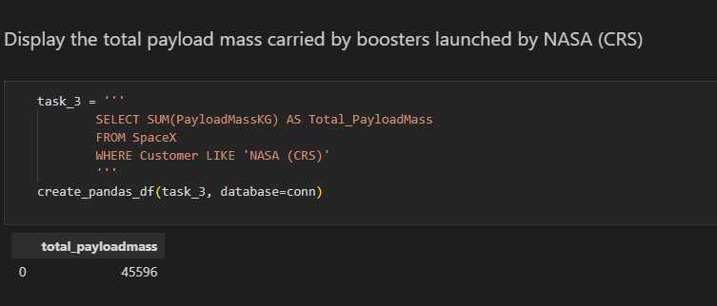
Total Payload Mass
Calculate the total payload carried by boosters from NASA

Slide 27
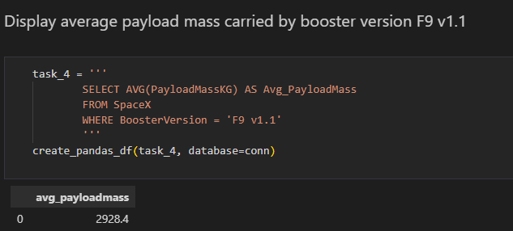
Average Payload Mass by F9 v1.1
Calculate the average payload mass carried by booster version F9 v1.1

Slide 28
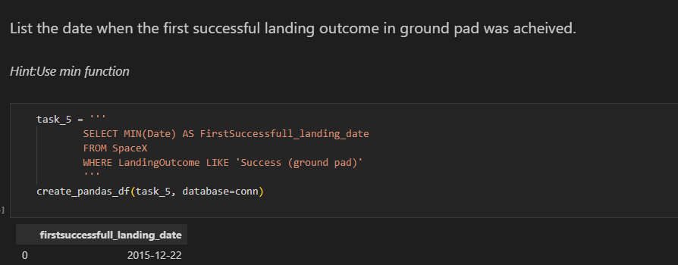
First Successful Ground Landing Date
Find the dates of the first successful landing outcome on ground pad

Slide 29
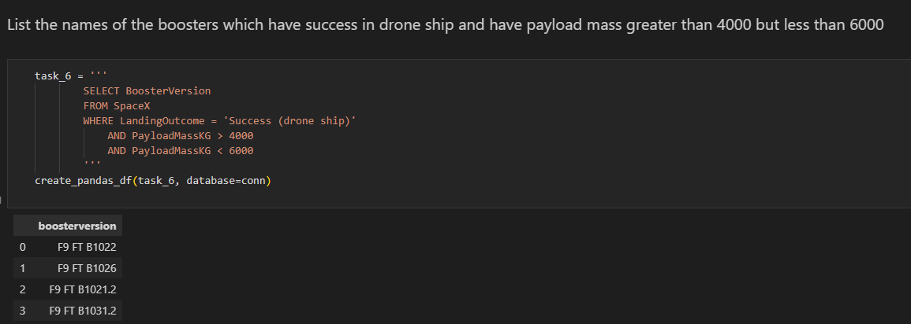
Successful Drone Ship Landing with Payload between 4000 and 6000
List the names of boosters which have successfully landed on drone ship and had payload mass greater than 4000 but less than 6000

Slide 30
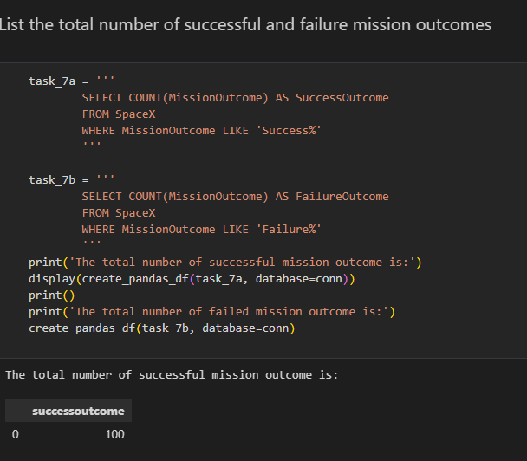
Total Number of Successful and Failure Mission Outcomes
Calculate the total number of successful and failure mission outcomes

Slide 31
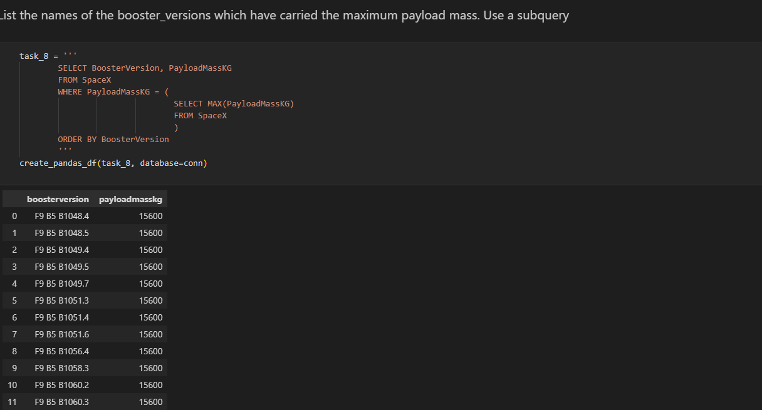
Boosters Carried Maximum Payload
List the names of the booster which have carried the maximum payload mass

Slide 32
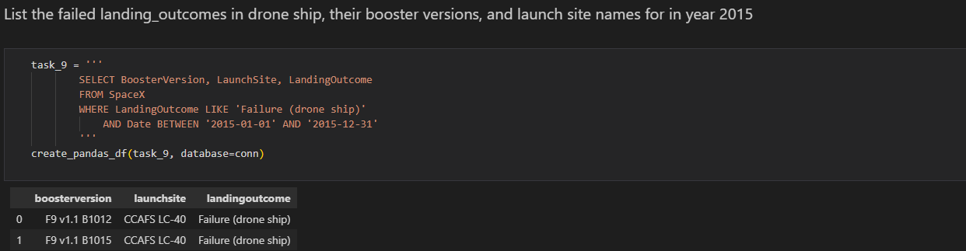
2015 Launch Records
List the failed landing_outcomes in drone ship, their booster versions, and launch site names for in year 2015

Slide 33
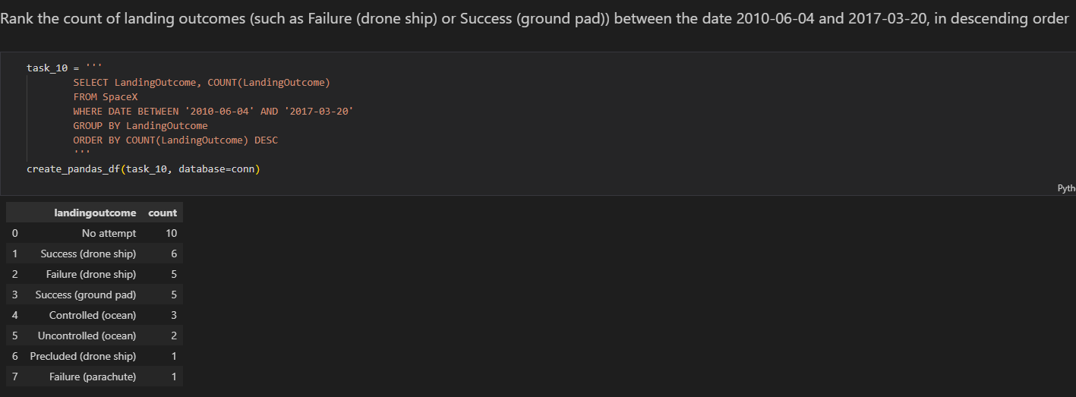
Rank Landing Outcomes Between 2010-06-04 and 2017-03-20
Rank the count of landing outcomes (such as Failure (drone ship) or Success (ground pad)) between the date 2010-06-04 and 2017-03-20, in descending order

Slide 34

Section 3

Slide 35
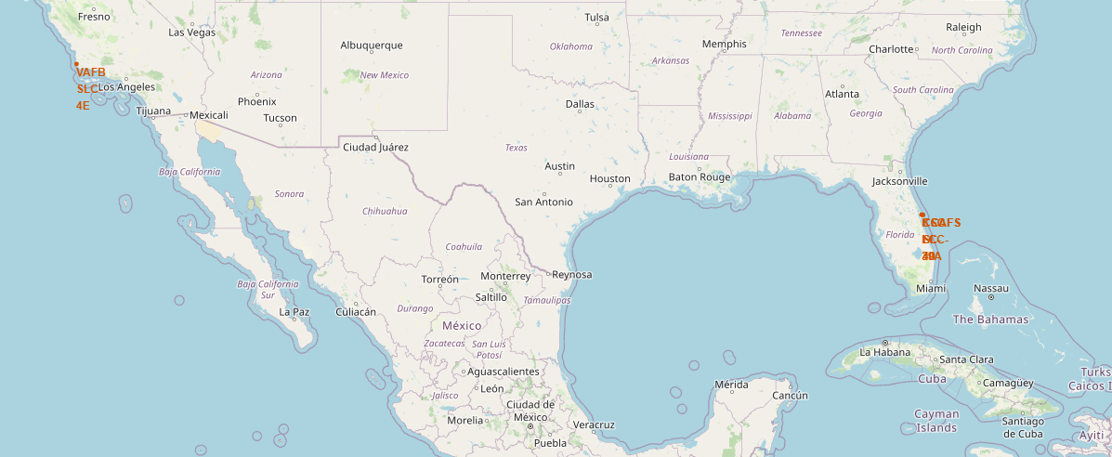
Launch Sites

Slide 36
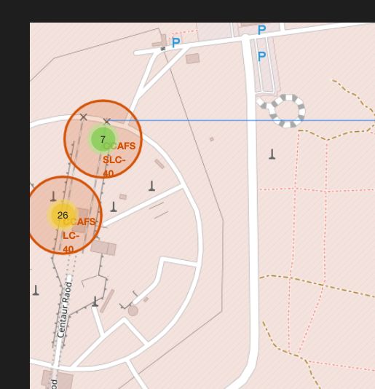
Launch site distance to landmarks

Slide 37
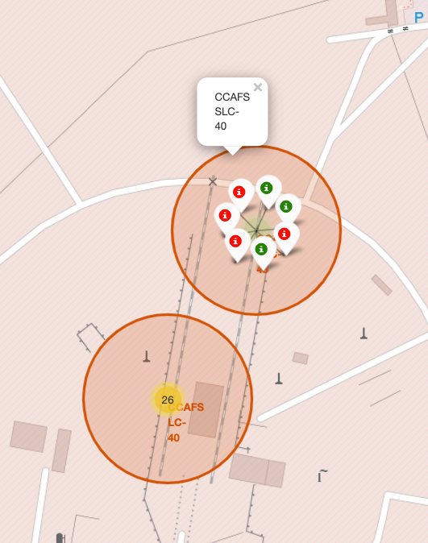
Launch Sites-2

Slide 38

Section 4

Slide 42

Section 5

Slide 43
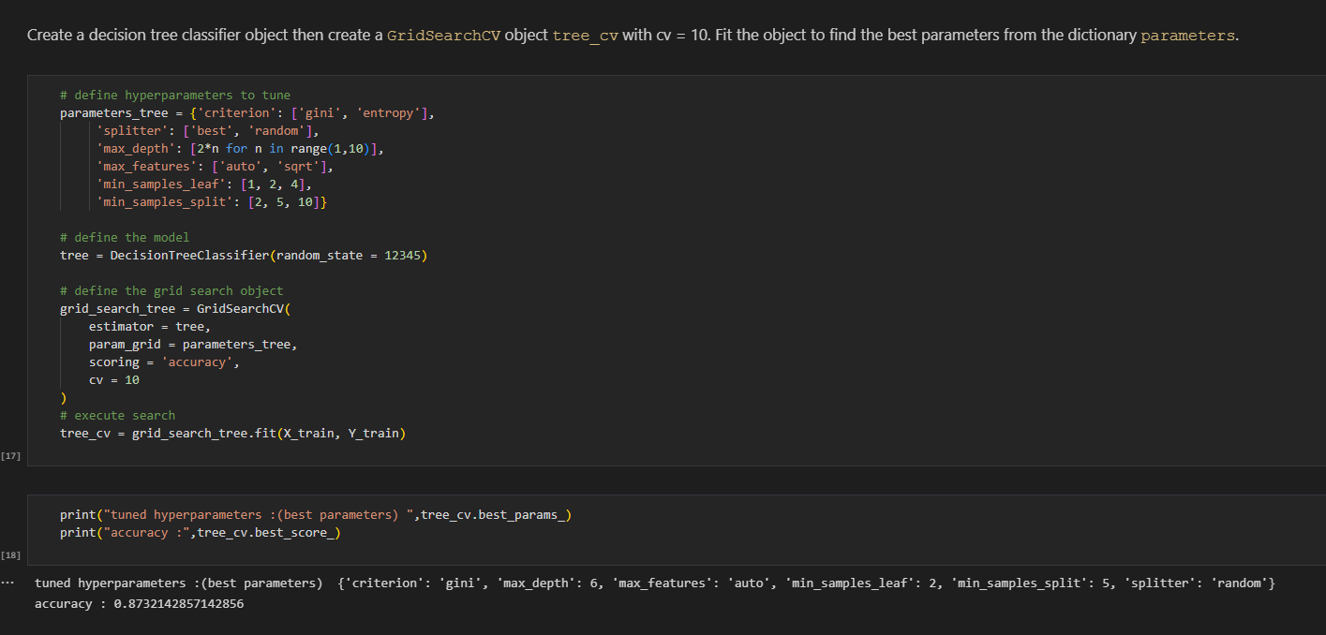
Classification Accuracy

Slide 44
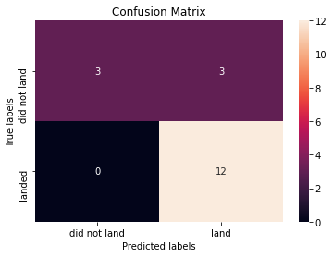
Confusion Matrix

Slide 45
Conclusions
Orbits ES-L1, GEO, HEO, SSO, VLEO had the most success rate.
KSC LC-39A had the most successful launches of any sites.
The Decision tree classifier is the best machine learning algorithm for this task

Slide 46


